Slide 1



Module 2.2
How Do Computers Understand What We Say?
Living and Working with Artificial Intelligence
Developed for the AI4GA (Artificial Intelligence for Georgia) project funded by National Science Foundation awards DRL-2049029 and DRL-2048502.
This work is licensed under the Creative Commons. Attribution-NonCommercial-ShareAlike 4.0 International License. https://creativecommons.org/licenses/by-nc-sa/4.0/

Slide 2

OBJECTIVES
Students should be able to:
  Explain how speech recognition works
  Explain what waveforms and spectrograms are.
  Explain the components of the human vocal tract.
  Give examples of how knowledge is used to disambiguate speech, e.g., disambiguating homophones based on context.

Slide 3




Discussion
Do you use speech recognition on your device?
If so, which apps do you use and how well does it work?
Notes:
Discussion 3-5 mins

Slide 4
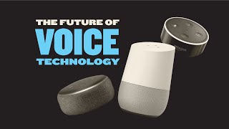
How Speech Recognition Works
https://www.youtube.com/watch?v=2RRT1YuyBCo (5 mins)
Notes:
1:17
Start for How speech recognition works
Teacher Note:

Slide 5
TODAY WE ARE GOING TO LEARN
HOW SPEECH RECOGNITION WORKS
Notes:
Teacher Note: Remind them that we did this the day before
Slides 3-5 - 5 mins

Slide 6
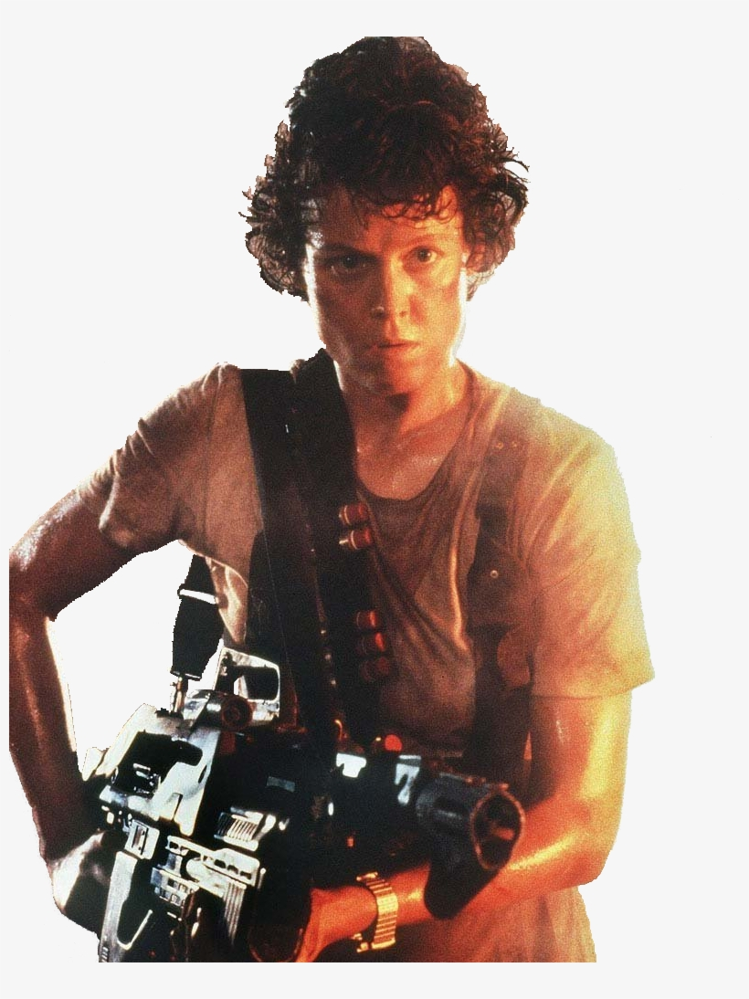


SPEECH RECOGNITION STARTS WITH SOUND
Physics tells us Sound is a rapid variation in air pressure
Because there’s no sound in a vacuum.
In space, no one can hear you scream.
Notes:
Teacher Note: We
Vo

Slide 7
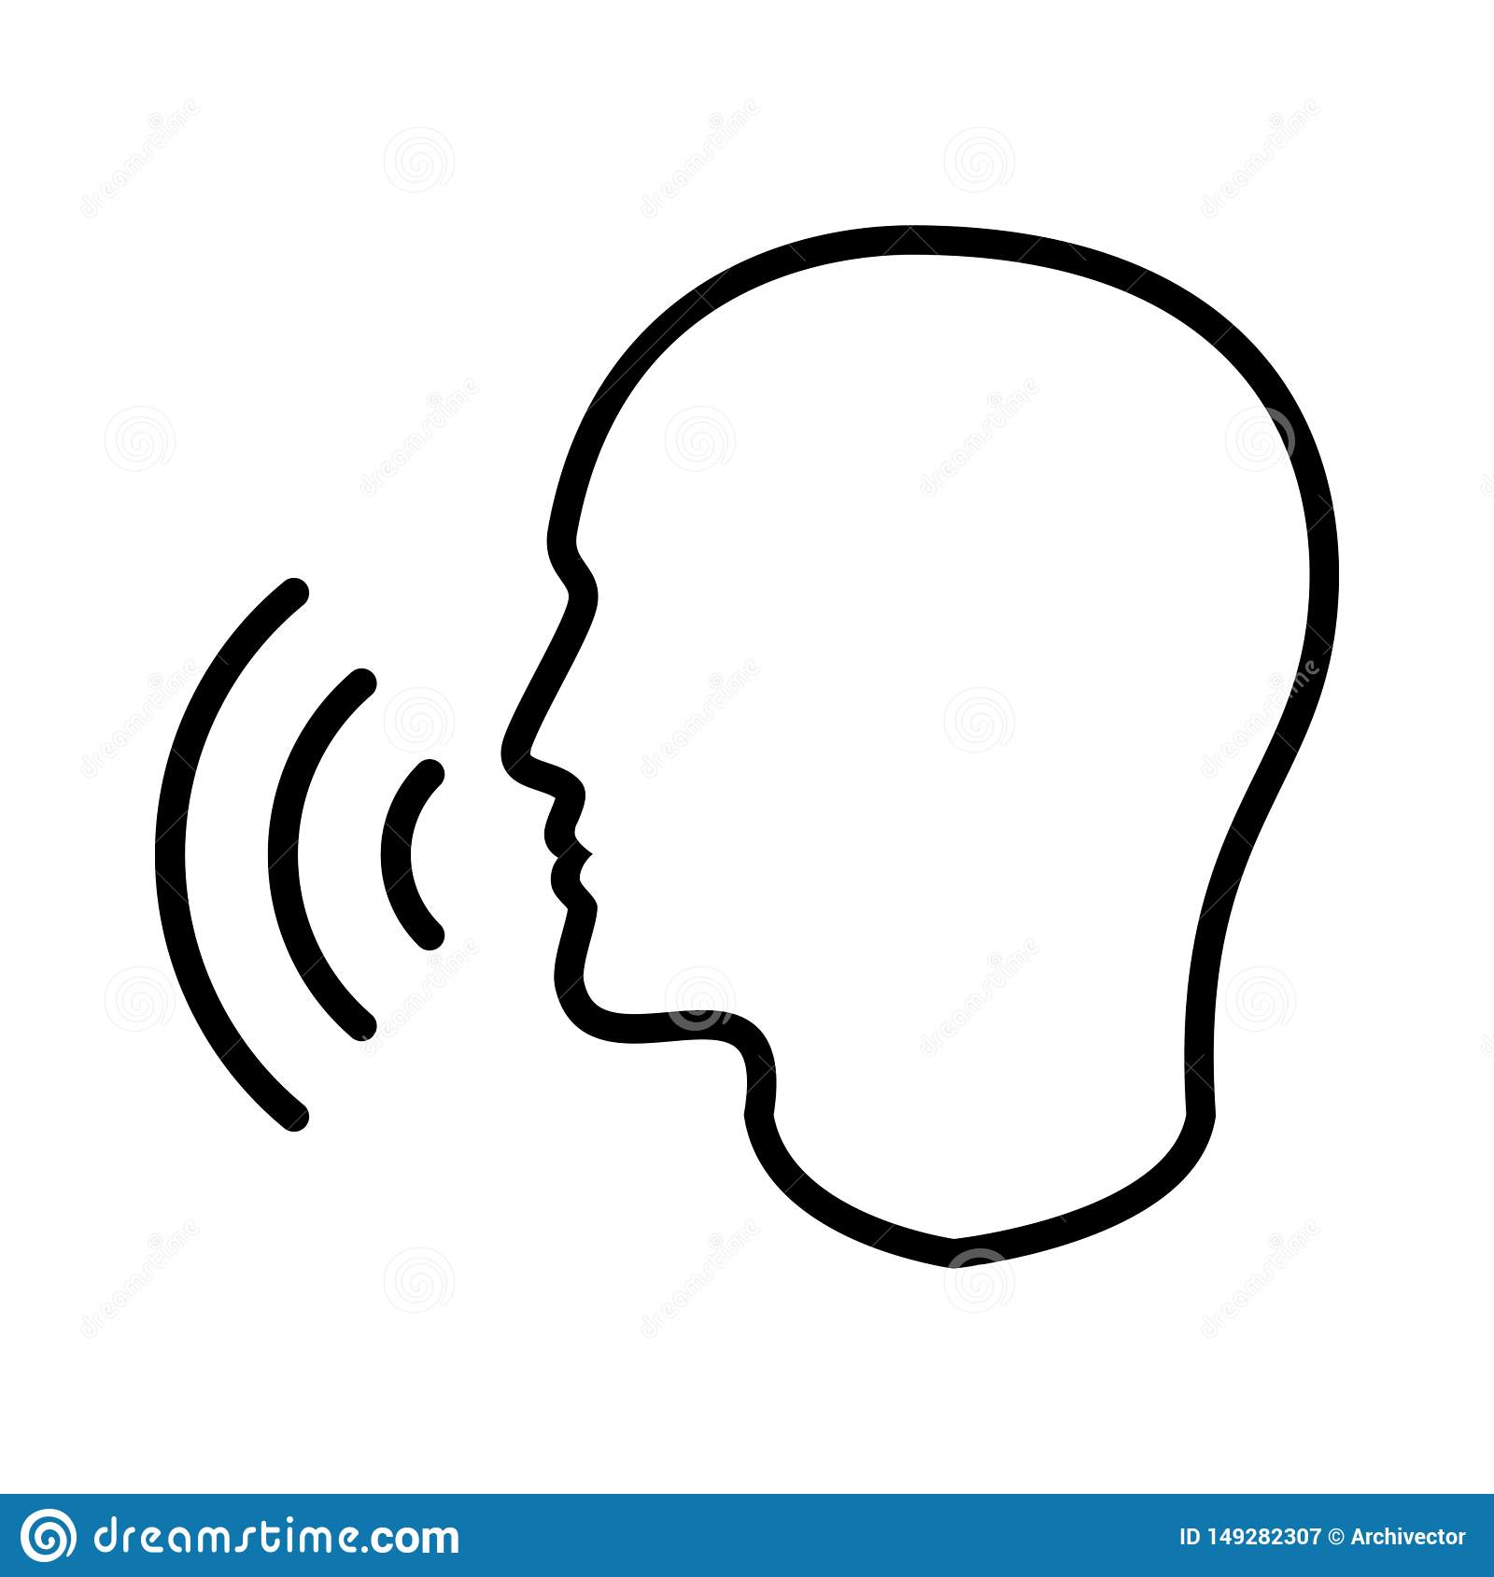

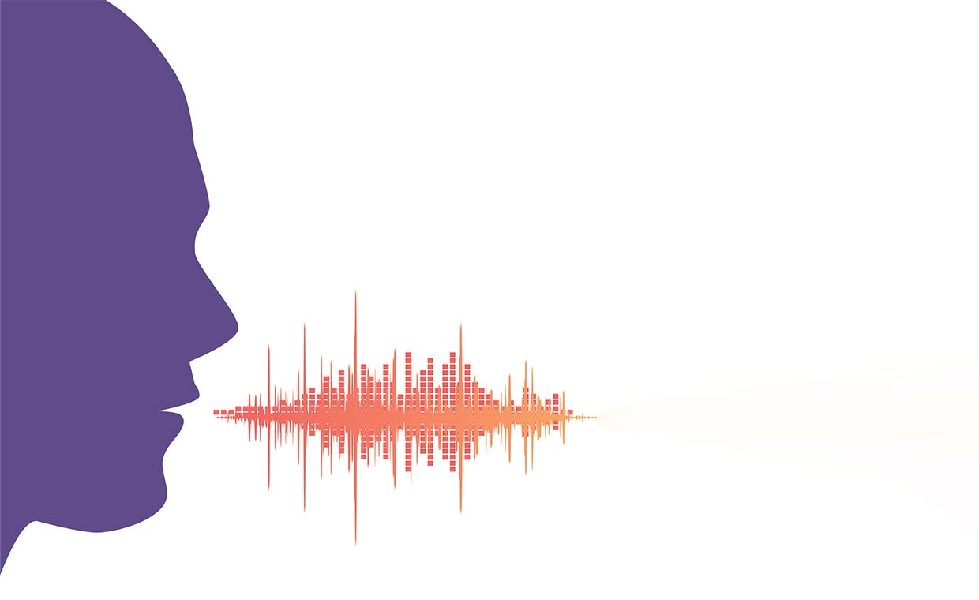
A MICROPHONE IS A SENSOR THAT TURNS SOUND INTO AN ELECTRICAL SIGNAL, OR “WAVEFORM”.
Sound waves are variations in air pressure.
When we make sounds the air is vibrating.
The microphone is converting
air pressure to voltage.
A Waveform
is a plot of the voltage over time.
Notes:
Vocabulary - A waveform is a plot of a time varying signal such as sound. They have time on the x axis and amplitude on the y.

Slide 8

LET’S LOOK AT HOW PEOPLE CREATE SOUNDS
https://www.youtube.com/watch?v=Wh4aEc4yPh0 (1 min)
Notes:
1 min

Slide 9
WHAT DID YOU NOTICE ABOUT HOW THE TONGUE AND LIPS WERE INVOLVED IN BEATBOXING?
Discussion
Notes:
Timing - 3-5 mins

Slide 10
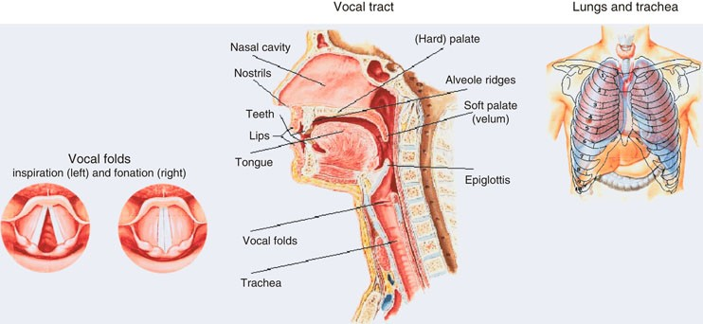
HUMAN ARTICULATORY APPARATUS:
HOW WE PRODUCE SPEECH
Source: https://link.springer.com/referenceworkentry/10.1007%2F978-0-387-73003-5_199
Notes:
Teacher Note: Humans have a very complex vocal instrument that includes the lips, tongue, and vocal cords. The lungs provide air that power the voice and the diaphragm controls the flow of air from the lungs through the vocal cords.
Vocabulary - Articulatory, Apparatus
Timing - 30 sec - 1 min

Slide 11
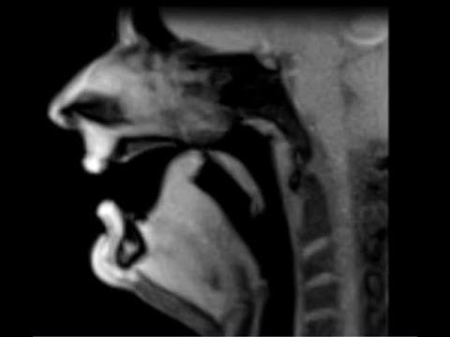
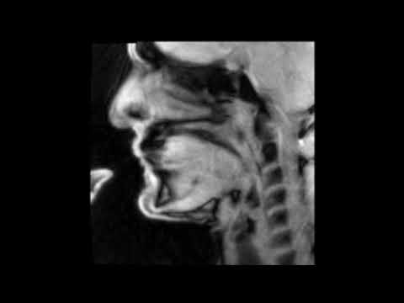
ADDITIONAL MRI VOCAL TRACT VIDEOS
Whistler: https://www.youtube.com/watch?v=Naeze0cvM9A
Trombone: https://www.youtube.com/watch?v=m0yAVe2Sz5M
Notes:
Teacher Note: These are optional if you have time and what the students to see more
Timing - 2-3 mins

Slide 12
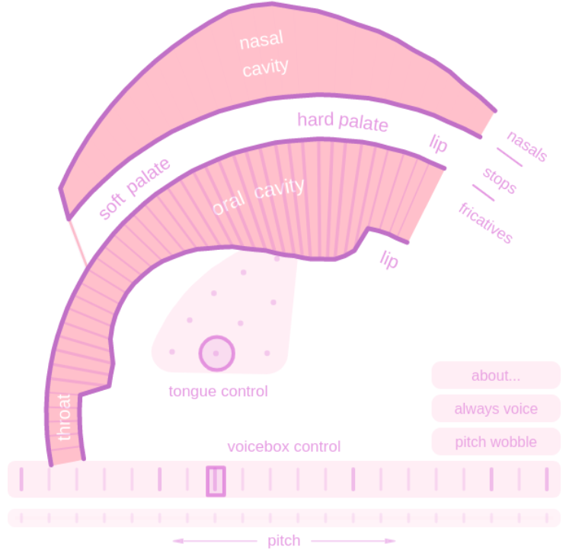
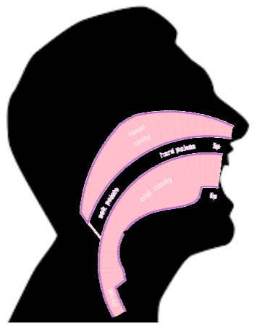
PLAY WITH THE VOCAL TRACT DEMO
(HUMAN VOCAL TRACT)
VOCAL TRACT DEMO: HTTPS://WWW.CS.CMU.EDU/~DST/VOCALTRACTDEMO
Video of the demo: https://experiments.withgoogle.com/pink-trombone
Notes:
Activity for the future
What are the settings (diagram) to get the following sounds
E
A
OO
What are the settings (diagram) to get the following sounds
FFFFF
SSSSS

Slide 13
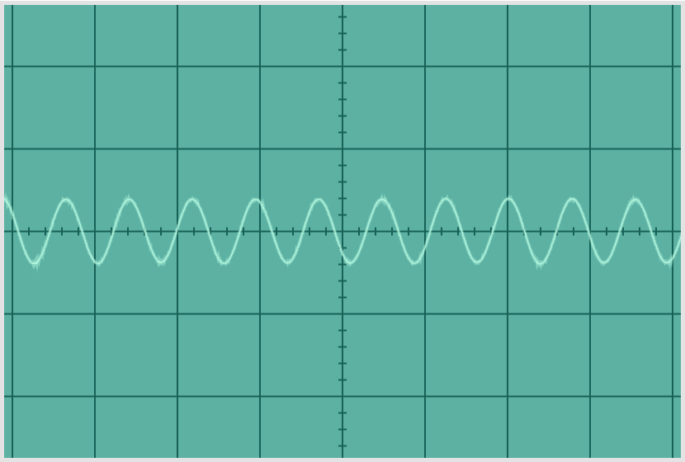
WHAT DOES SOUND LOOK LIKE?
Oscilloscope - a device for displaying waveforms
Amplitude
Time
Notes:
To Do: Add a screenshot of the oscilloscope

Slide 14
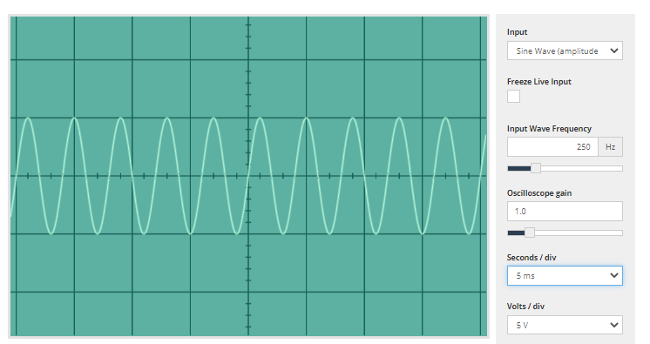
TRY IT: OSCILLOSCOPE DEMO
STEP 1: OPEN: HTTPS://ACADEMO.ORG/DEMOS/VIRTUAL-OSCILLOSCOPE/
STEP 2: SET SECONDS/DIV TO 5 MS
STEP 3: TALK INTO THE MIC
TO SEE WHAT YOUR
SPEECH LOOKS LIKE
Notes:
To Do: Add a screenshot of the oscilloscope
Timing - 10 mins

Slide 15
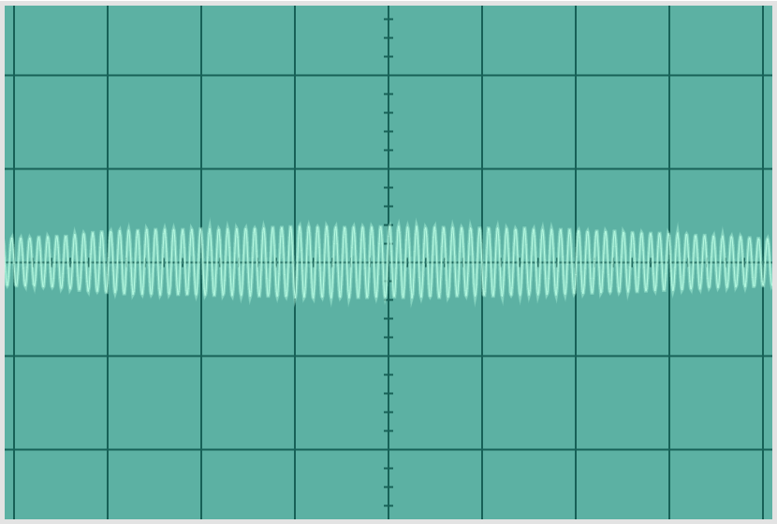
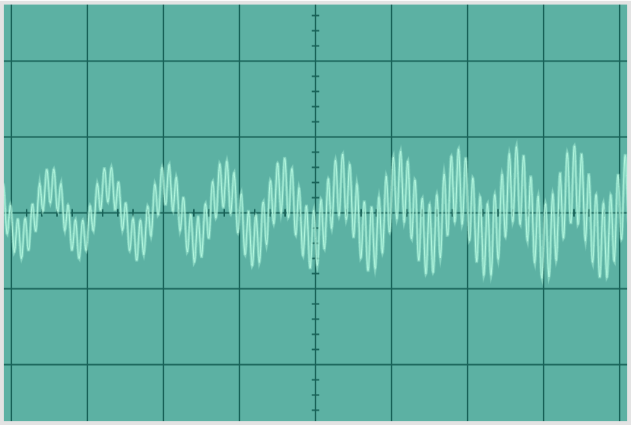
LET’S CHOOSE A SIMPLE TYPE OF SOUND TO MAKE THE WAVEFORM UNDERSTANDABLE
STEP 3: IF YOU HAVE AN ELECTRONIC KEYBOARD YOU SHOULD SELECT AN ELECTRONIC ORGAN VOICE
IF NOT, YOU CAN USE A VIRTUAL KEYBOARD:
HTTPS://WWW.IGORSKI.NL/APPLICATION/WEBSID/
HTTPS://WWW.ONLINEPIANIST.COM/VIRTUAL-PIANO
STEP 4: PLAY A LOW NOTE AND THEN PLAY A HIGH NOTE. HOW DO THEY DIFFER?
STEP 5: PLAY A LOW NOTE AND A HIGH NOTE AT THE SAME TIME. HOW DO THE WAVEFORMS COMBINE?
low C
very high C
low + very high C
Notes:
Teacher note:
Low notes - have a smaller number of cycles per second
High notes - have a larger number of cycles per second
Low+high notes - when you combine these together you get a complex waveform where it is not so obvious how you count cycles per second. This is closer to what human speech looks like.

Slide 16
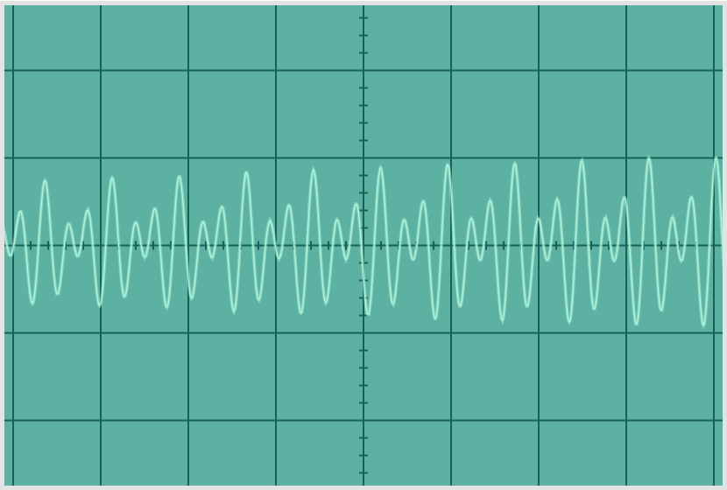
TRY PLAYING A CHORD:
MIDDLE C PLUS G GIVES A MORE COMPLEX WAVEFORM
Amplitude
Time
Notes:
Vocabulary - waveform, spectogram, Oscillascope
Teacher Note:
Slides 7-9 - 10 mins

Slide 17
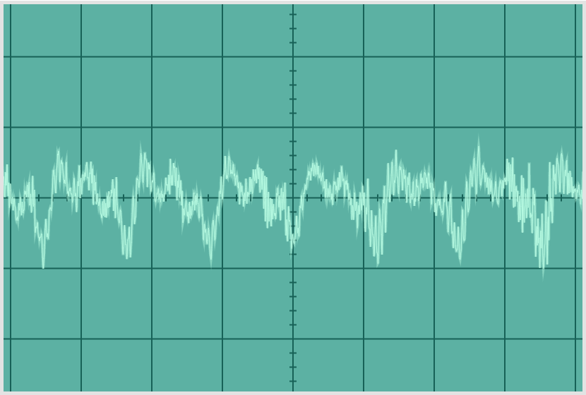
HOWEVER, HUMAN SPEECH IS A VERY COMPLEX WAVEFORM
Amplitude
Time
Notes:
Teacher Note: Although the waveform is very complex, there is still structure here. It is just hard to see. So let’s look at it a different way using a spectrogram.
Timing - slides 14-15 - 1 min

Slide 18
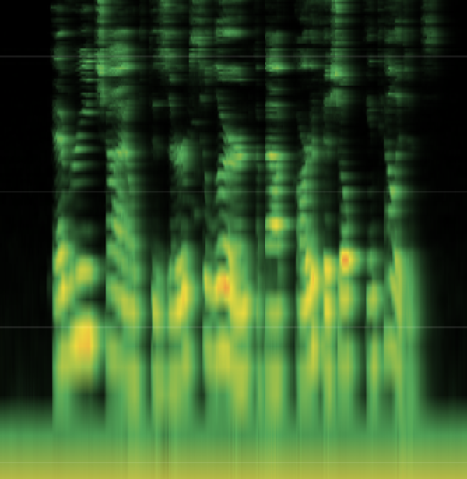
A SPECTROGRAM SHOWS THE FREQUENCY COMPONENTS OF SOUNDS
This is human speech.
Do you see any differences in the axis labels?
Frequency
Time
Notes:
Teacher Note: Notice the difference in the axis. For the oscilloscope the y-axis is amplitude. For the spectrogram the y-axis is frequency. We’ve chosen to go to the frequency domain because it reveals structure in the waveform that is hard to see when we look at amplitude.

Slide 19
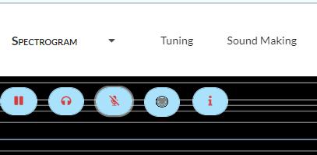
TRY IT: SPECTROGRAM DEMO
STEP 1: OPEN HTTPS://SPECTROGRAM.SCIENCEMUSIC.ORG/
STEP 2: CLICK ON THE MICROPHONE ICON TWICE TO
START THE DEMO.
STEP 3: MAKE SOUNDS AND OBSERVE THE
SPECTROGRAM.
Frequency
Spectrogram Activity Sheet
Time
Notes:
ADD To student resources how to do a split screen
Timing - 10 mins

Slide 20


HOW TO READ A SPECTROGRAM
This spectrogram shows the frequency: low C
This spectrogram shows the frequency: very high C
Amplitude
Frequency
Frequency
Amplitude
Time
Time
Time
Time

Slide 21


HOW TO READ A SPECTROGRAM
THIS SPECTROGRAM SHOWS THE CHORD: LOW + VERY HIGH CC
This spectrogram shows shows the chord: middle C plus G
G
Frequency
C
Frequency
C
C+G
Amplitude
Amplitude
Time
Time
Time
Time

Slide 22

HUMAN SPEECH
SPEECH SPECTROGRAM OF DAVE SAYING:
“EVERY CHILD DESERVES TO LEARN
ABOUT ARTIFICIAL INTELLIGENCE.”

Slide 23
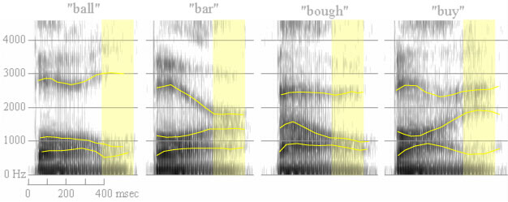
READING A SPECTROGRAM OF HUMAN SPEECH:
FORMANTS F1, F2, AND F3
F3
F2
F1
Formants are bands of high energy in the speech signal.
Different vowels and consonants have different formant patterns.
Notes:
Teacher Note: Notice the frequency bands in these images. Formats are some of the structure in a spectrogram.
Slides 21-22 - 1 min

Slide 24
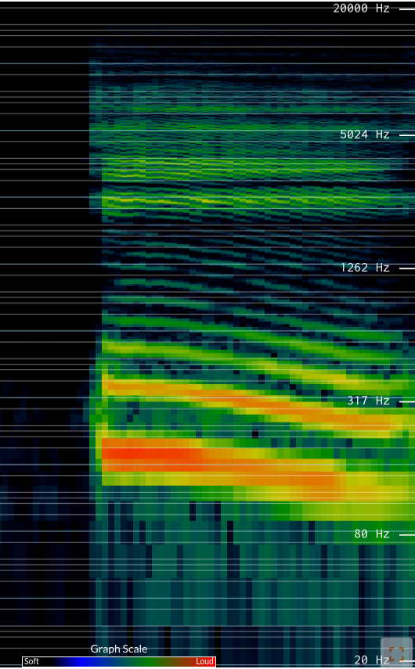
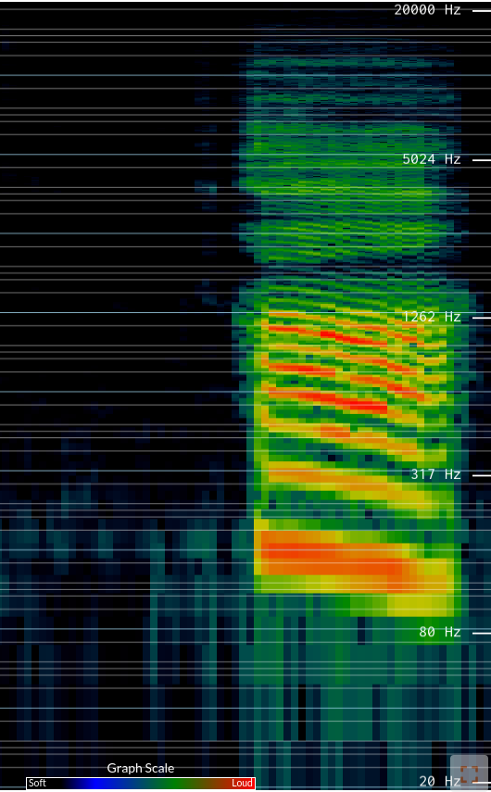
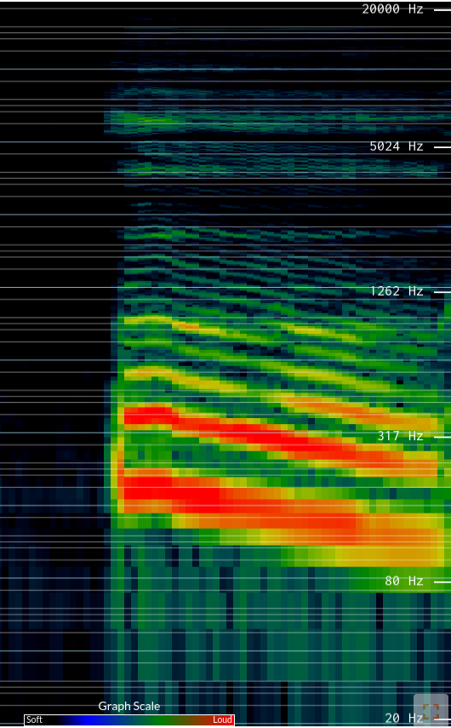
/i/ as in “bleed”
/a/ as in “block”
/u/ as in “blue”
Notes:
In-class exercise: have a student speak the three vowels shown and ask the class to describe how their spectrograms differ. Then ask another student to leave the room. Have the first student speak a vowel at random and freeze the spectrogram display. Then bring the second student back and see if they can guess which vowel was spoken. {This is a good stopping point for the 1st day; after a quick review begin with slide 24 the following day}

Slide 25
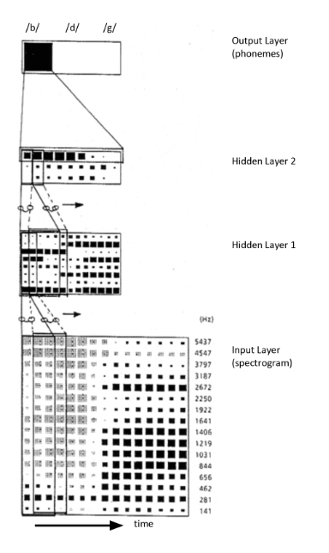
FROM SPECTROGRAMS TO SOUNDS
THIS IS AN EARLY 1980S CONVOLUTIONAL NEURAL NET
THAT RECOGNIZES SOUNDS.
SPECTROGRAMS GO IN; SOUNDS (PHONEMES) COME OUT:
IN THIS CASE /B/, /D/, OR /G/.
waveform
spectrogram
neural network (phoneme recognizer)
Notes:
In the future - This will be a demo
Vocabulary - Neural Network
Teacher Note: This is a simplified form of how modern day speech recognition works. We start with the waveform and transform it into a spectrogram and then we feed it into a neural network that recognizes sounds based on their spectrogram patterns. Out comes the sounds it recognizes. This is a very simple example that only recognized b, d, g. To do full blown speech recognition requires a much larger and more complicated neural network.

Slide 26

HOW DO COMPUTERS UNDERSTAND WHAT WE SAY?
Let’s return to our original question:
UNDERSTANDING IMPLIES GRASPING THE MEANING OF WHAT WE SAY.
Notes:
Possibly make this the start of the slide deck and make the other things activities for the students to do.

Slide 27
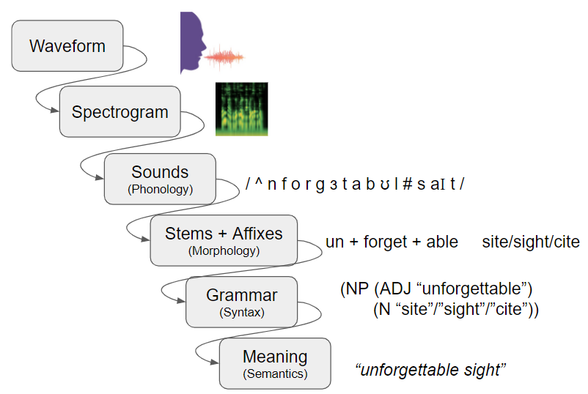
WHERE DOES MEANING COME FROM?
The audio abstraction pipeline
The transformation from sound to meaning takes place in stages, with increasingly abstract features and higher level knowledge applied at each stage.
Notes:
Teacher Note: Understanding implies grasping the meaning. So where does meaning come from?
The few slide ago we highlighted the first three stages of the audio abstraction pipeline. Now we will learn about the remaining stages.
Note: It is a pipeline because you are feeding information/representations from one stage to the next and each stage is doing some type of transformation.

Slide 28

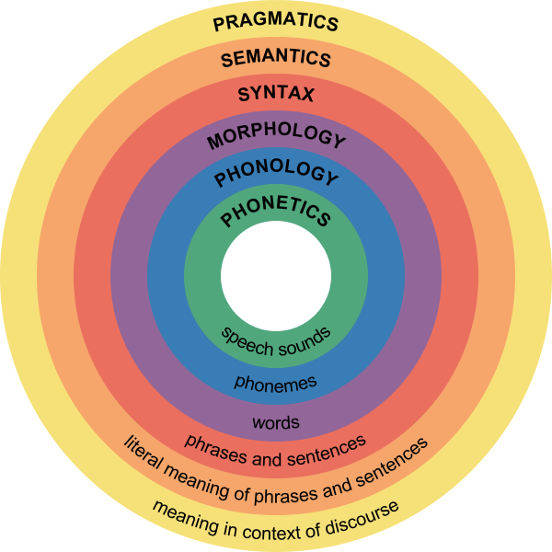

What people understand about their own language
Every language has a lexicon consisting of all the words in that language.
All languages have a grammar: a set of rules for generating logical communication.
While every language has a different set of rules, all languages do obey rules.
You subconsciously know the rules of your language even though you probably can’t say what they are.
Major Levels of Linguistics
Notes:
Teacher note: This slide is animated.
Vocabulary - subconscious (learning from exposure),
combinatorial
Source: https://courses.lumenlearning.com/boundless-psychology/chapter/introduction-to-language/
Image Source:

Slide 29
What knowledge do smart assistants need to understand human speech
Notice any similarities for earlier slides?
Smart assistant use the same information that humans use to understand speech.

Slide 30
Meet our resident sound expert - Xenomorph from the movie Alien.
She will tell us all about the stages of the audio abstraction pipeline.
“unforgettable sight”
Sound is variations in air pressure.
When we speak, the air is vibrating.
Notes:
Teacher Note: Meet our resident sound expert - Xenomorph from the movie Alien. He will tell us all about the stages of the audio abstraction pipeline.
N

Slide 31
A microphone turns sound into an electrical signal, or “waveform”.
“unforgettable sight”
waveform
“unforgettable sight”
Notes:
Teacher Note: waveforms are representations of sound

Slide 32
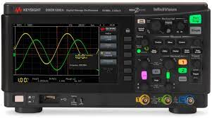
sound waves
waveform
spectrum analyzer
spectrogram
“unforgettable sight”
A spectrum analyzer turns the waveform into a spectrogram.
Notes:
Teacher Note: Notice that we have added a spectrum analyzer and it produces a spectrogram. Spectrum Analyzers transform waveforms into spectrograms. Usually this is done in software by a computer, but there are also special-purpose spectrum analyzers you can purchase for laboratory use.

Slide 33
sound waves
waveform
spectrum analyzer
spectrogram
“unforgettable sight”
phoneme recognizer
(sounds)
/ ^ n f o r g ɜ t a b ʊ l # s aI t /
Sounds (phonemes) can be extracted from the spectrogram.
Notes:
Teacher Note: Then spectrogram is fed into a phoneme recognizer. The phonemes (sounds) are written in linguistic notation, using special symbols to denote sounds rather than letters. The “#” symbol denotes a word boundary. Sounds (phonemes) can be extracted from the spectrogram.
As we move through this description of the audio abstraction pipeline, we are alternating between the representation (e.g., sound waves, spectrogram) and the transformer (e.g., microphones, spectrum analyzer, phoneme recognizer)

Slide 34
sound waves
waveform
spectrum analyzer
spectrogram
phoneme recognizer
/ ^ n f o r g ɜ t a b ʊ l
# s aI t /
“unforgettable sight”
morpheme recognizer
(stems and affixes)
un + forget + able site/sight/cite
Morphemes (word stems and affixes) can be assembled from phonemes. But /s aI t/ is ambiguous: is it “site” or “sight” or “cite”?
Notes:
Teacher Note: The phoneme representation is fed into the morpheme recognizer. Morphemes (word stems and affixes) can be assembled from phonemes. Notice that /s aI t/ has three possible words listed. This is because “sight”, “site”, and “cite” are homophones: words that sound the same but are spelled differently.

Slide 35
sound waves
waveform
spectrum analyzer
spectrogram
phoneme recognizer
/ ^ n f o r g ɜ t a b ʊ l
# s aI t /
“unforgettable sight”
morpheme recognizer
(stems and affixes)
un + forget + able
site/sight/cite
parser
(syntax)
(NP (ADJ “unforgettable”)
(N “site”/”sight”/”cite”))
A parser assigns grammatical categories to words and groups them into phrases. “NP” means noun phrase.
Notes:
Teacher Note: The morepheme representation is then transformed by the parser. A parser assigns grammatical categories to words and groups them into phrases. “NP” means noun phrase. Notice that sight has three possible words listed. This is because sight is a homophone (two or more words that sound the same but are spelled differently) - site, sight, and cite.

Slide 36
sound waves
waveform
spectrum analyzer
spectrogram
phoneme recognizer
/ ^ n f o r g ɜ t a b ʊ l
# s aI t /
“unforgettable sight”
(NP (ADJ “unforgettable”)
(N “site”/”sight”/”cite”))
morpheme recognizer
(stems and affixes)
parser
(syntax)
un + forget + able
site/sight/cite
A semantic analyzer gives the meaning of the phrase and resolves the ambiguity.
semantic analyzer
(meaning)
unforgettable sight
Notes:
Teacher Note: In the last stage of our audio abstraction pipeline, the parsed representation is fed into semantic analyzer. A semantic analyzer gives the meaning of the phrase and resolves the ambiguity. Notice that sight has two possible words listed. This is because sight is a homophone (two or more words that sound the same but are spelled differently) - site and sight.

Slide 37
RECAP: THE AUDIO ABSTRACTION PIPELINE
Waveform
Spectrogram
Sounds
(Phonology)
/ ^ n f o r g ɜ t a b ʊ l # s aI t /
Stems + Affixes
(Morphology)
un + forget + able site/sight/cite
Grammar
(Syntax)
(NP (ADJ “unforgettable”)
(N “site”/”sight”/”cite”))
Meaning
(Semantics)
“unforgettable sight”
Notes:
Teacher Note: Note the difference between the representation of the audio abstract pipeline on this slide vs. the previous slide. Slide 25 includes the transformations between stages and this one does not.

Slide 38
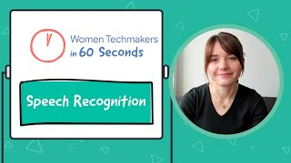
VIDEO SUMMARY OF THE AUDIO ABSTRACTION PIPELINE in MODERN AI Systems
Career Highlight:
Machine Learning Engineer
https://www.youtube.com/watch?v=eQfqcYR3HJo (1:39 min)
Notes:
New as of July 2024 - Christina Added

Slide 39
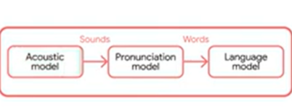

AUDIO ABSTRACTION PIPELINE in MODERN AI Systems
sound waves
waveform
unforgettable sight
sound waves
waveform
unforgettable sight
Notes:
New as of July 2024 - Christina Added

Slide 40

OPTIONAL VIDEO SUMMARY OF THE AUDIO ABSTRACTION PIPELINE
https://youtu.be/uSNUmJffK4c?si=NqHPMVY5bX2EavL6 (2:18 mins)
Notes:
New Video -
Parsing Tree Video - https://www.youtube.com/watch?v=iNbOOgXjnzE

Slide 41

HOW DO COMPUTERS RESOLVE AMBIGUITIES IN SPEECH?
Fact:
Speech is ambiguous

Slide 42
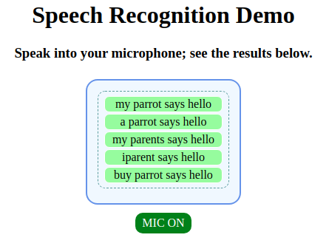
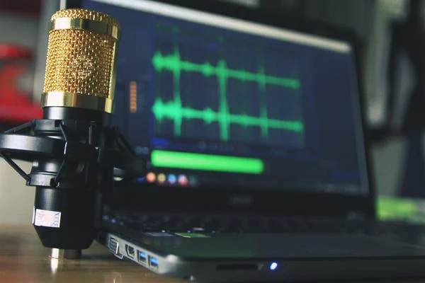
GOOGLE SPEECH API: REVEALING THE AMBIGUITY
HTTPS://WWW.CS.CMU.EDU/~DST/SPEECHDEMO
Try this Demo & Tutorial:
What do you observe about how this demo works?
Notes:
Teacher Notes:
What do you observe about how this demo works?
It has multiple guesses of what you might have said
These alternative are ranked
The first guess is usually correct
The question is how does it figure out which guess is correct?
Do SpeechDemo exercises on homophones etc.
Take-away - Google is really good at disambiguating homophones when they are used in sentences.
Discussion: What knowledge is Google using to choose the most likely words?
Demo - Try giving words and non-words to SpeechDemo and see which ones it can handle.
Discussion -
Which ones of these could be words in English, and which ones could not? Why?
“Floop”, “fnoop”, “froop”, “fsoop”
Take-away - Speech understanding systems need to understand the phonology (the way things sound) of languages. English and languages have phonological rules for words, vowels, and constant pronunciation. Opportunity to bring in other cultures and languages.
May need to provide resources

Slide 43
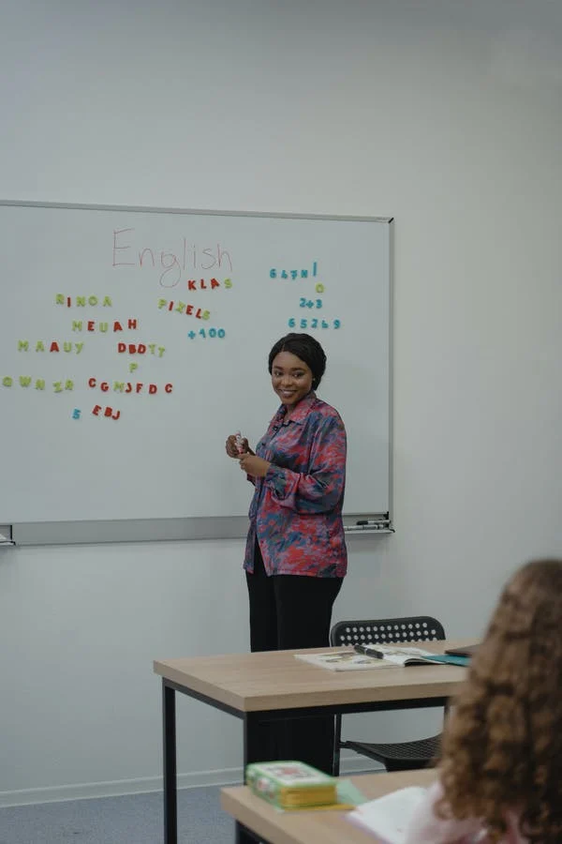
SPEECH IS AMBIGUOUS
A corpus (pl. corpora) is a collection of spoken or written text.
THE FOLLOWING PHRASES SOUND THE SAME:
“HOW TO RECOGNIZE SPEECH”
“HOW TO WRECK A NICE BEACH”
HOW DO WE COPE WITH AMBIGUITY?
MULTIPLE SOURCES OF CONSTRAINT: PHONOLOGY, MORPHOLOGY, SYNTAX, SEMANTICS
STATISTICAL KNOWLEDGE ABOUT WORD SEQUENCES GAINED FROM HUGE CORPORA
**EXAMPLES OF HOMOPHONES
https://i.pinimg.com/474x/38/9a/ee/389aeee6471d961267acef6b4e80cc6d.jpg
https://i.pinimg.com/originals/00/57/eb/0057eb7ebba044b1faec62f46eae1462.jpg
Notes:
Vocabulary: Corpora
Teacher note: Have the students try saying these two sentences so that they can see that they sound very similar.
Teacher Note: The speech recognition system knows about the sound patterns of the language, its stems and affixes, and its grammar, and it uses all this knowledge to resolve ambiguities.
Optional Details if students have questions:
Sound constraints - The system knows the allowable phonemes for each language. For example Chinese has allowable sounds that english doesn’t have.
Languages have rules for the letters that appear together. Computers use these rules to resolve ambiguities.

